Slide 1


MCA21 Version 3 – Implementation of Annual Filing Forms

Slide 2

Key Features – New Annual Filing Forms

Slide 3

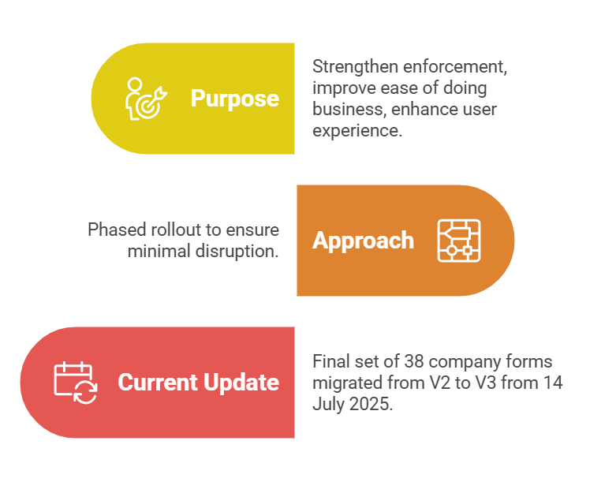


Key Features – V3 Portal

Slide 4
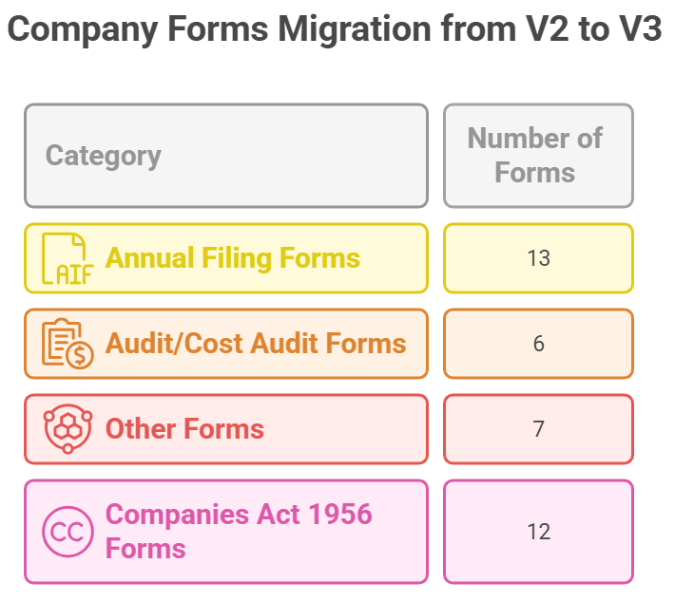
Key Features – New Annual Filing Forms

Slide 5
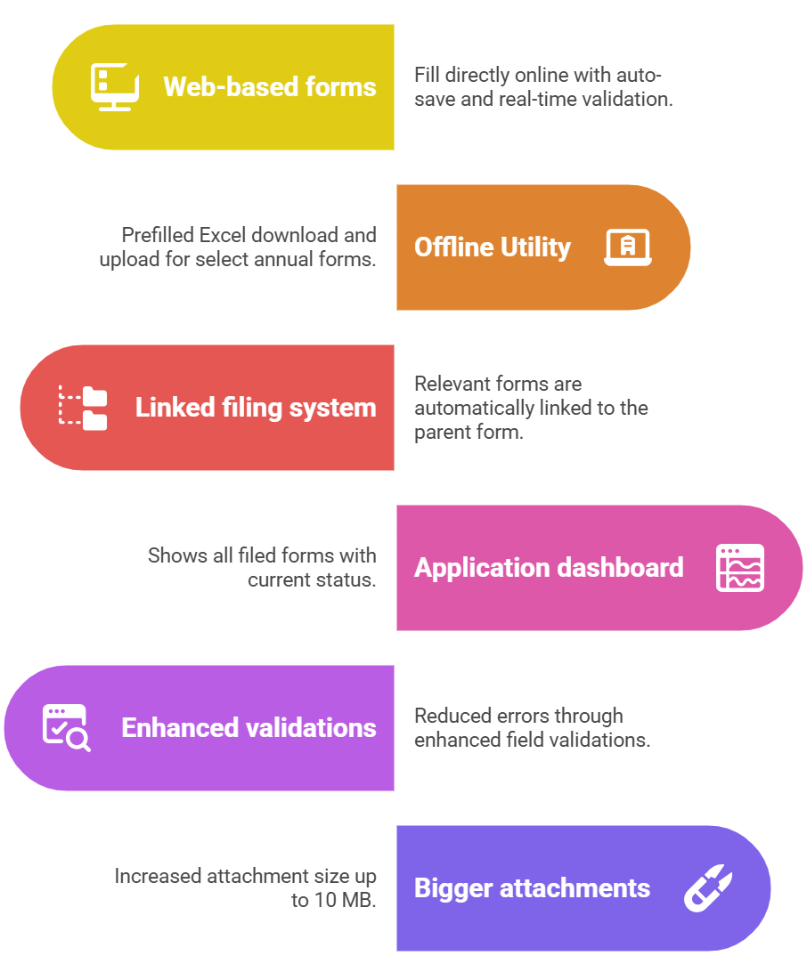
Key Features – New Annual Filing Forms

Slide 6
Key Features – New Annual Filing Forms
Major Differences V2 vs V3
Feature | V2 | V3
Form filling | Offline PDF upload | Web-based form
Prefill | Limited | Auto prefill from linked records

Slide 7
Linked Filing System

Slide 8
Linked Filing System:
“5” new Annual Filing forms got rolled out in V3 as new electronic forms (previously filed as an attachment):
AOC-1- Statement containing salient features of the financial statement of subsidiaries / associate companies/ joint ventures;
AOC-2 - Form to disclose company’s related party contracts/arrangements under Section 188, including specified arm’s length transactions;
Extract of Auditor’s Report (Consolidated)
Extract of Auditor’s Report (Standalone)
Extract of Board’s Report

Slide 9
Linked Filing System:
Attachments like AOC-1, AOC-2, Board’s Report → now as linked web-forms.
CSR section removed from AOC-4 → details in CSR-2 or Board’s Report;
Mandatory linked filing:
Extract of Board’s Report
Extract of Auditor’s Report (Standalone)
Linked forms triggered based on applicability (subsidiaries, consolidation, related party transactions).
Auto population of last year’s figures (editable).
Option to file online or offline.

Slide 10
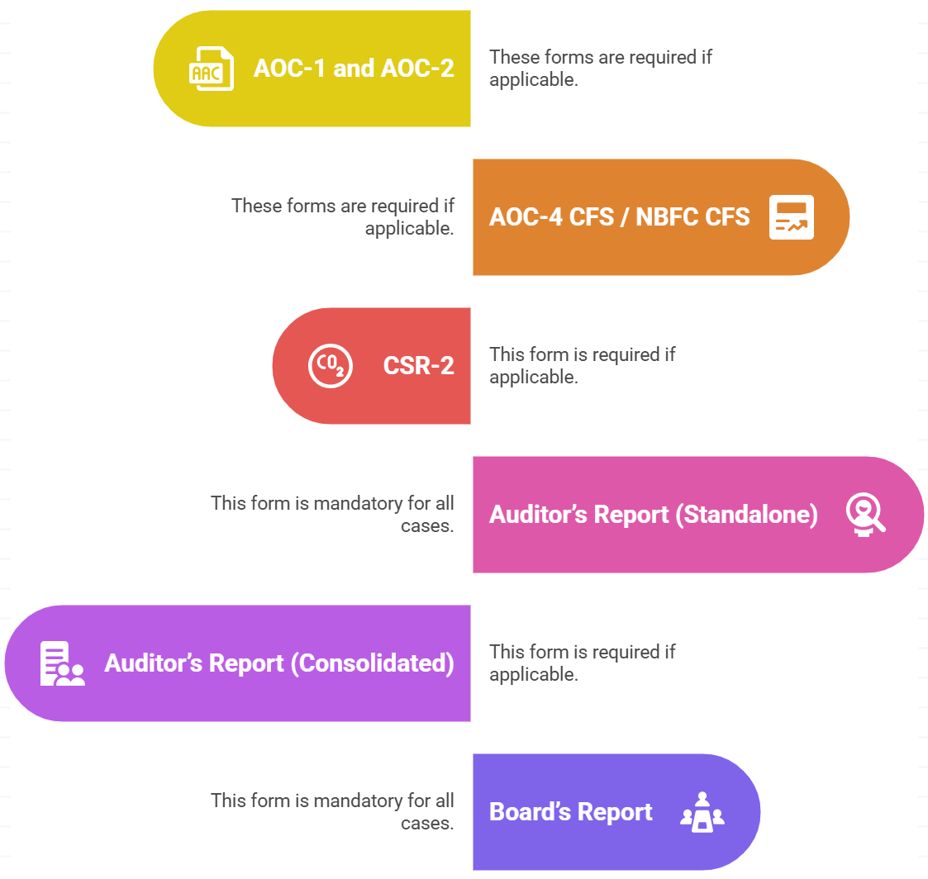
Linked Filing System:
Linked forms are triggered based on fields selected in the parent form (e.g., CSR applicability, subsidiaries, etc.)
* In case of AOC-4(XBRL), only Form CSR-2 will be filed as linked form.

Slide 11
Linked Filing System:
Important Note :
While the attachment “Directors Report” got removed, however copy of financial statements (including Board‘s report, auditors‘ report, and other documents) is be attached mandatorily while filing AOC-4, AOC-4 CFS, AOC-4 NBFC and AOC-4 NBFC CFS.
Also, above mentioned attachment is required to be attached while filing AOC-4 XBRL in addition to XBRL financial statements.

Slide 12
Mode of Filing

Slide 13
Mode of Filing:
Dual Filing Options: Users can now file the forms via online (web-based) or offline (Excel-based upload) mode.
In offline mode, users can enter basic details in the web form to download a pre-filled Excel, complete it offline, and then upload the Excel for final submission.
Web form fields which are pre-filled are non-editable in Excel.
All linked forms must be uploaded successfully for submission to proceed.
SRN is generated only after validation and successful submission of each form.

Slide 14
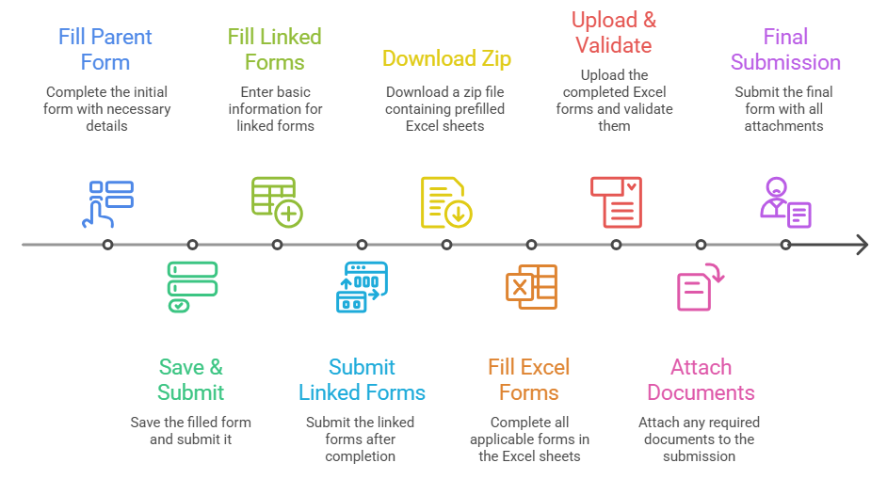
Mode of Filing:
Offline Form Filing Process
Note: Offline form filing option is not available for Form AOC-4 XBRL.

Slide 15
Mode of Filing:
Important points to be kept in Mind for old filing–
Previous year filings are allowed in V3 subject to payment of required additional fees.
AOC-4 CFS/AOC-4 NBFC CFS can be filed independently only for those SRNs for which AOC-4/AOC-4 NBFC were filed in V2.
For all the prospective filings, it will be mandatorily filed as a linked form with AOC-4/AOC-4 NBFC.

Slide 16
Key Changes in Forms

Slide 17
Key Changes in Forms:
AOC-4:
Dual filing options – online (web-based) or offline (Excel-based upload) mode.
Linked Web Forms –
Extract of Board’s Report, Extract of Auditor’s Report (Standalone);
AOC-4 CFS and Extract of Auditor’s Report (Consolidated), if consolidation is applicable;
CSR-2 form , wherever applicable.
AOC-1 & AOC-2 (if applicable).
Standalone & consolidated signed FS attachments.
Form Signing Enabled by IRP/RP/Liquidator in case of company under CIRP/ under liquidation.

Slide 18
Key Changes in Forms:
AOC-4 XBRL:
Only web based (single) filing option.
CSR Applicability Fields Introduced.
Mandatory CSR-2 linked (if applicable) from FY 2024-25.
Mandatory attachments of Standalone signed financial statements along XBRL.
Form Signing Enabled by IRP/RP/Liquidator in case of company under CIRP/ under liquidation.

Slide 19
Key Changes in Forms:
MGT-7 / MGT-7A:
Dual filing options – online (web-based) or offline (Excel-based upload) mode.
Mandatory field w.r.t. gender-wise shareholder count.
Registered office external building photo as an attachment.
MGT-8 (Certificate by PCS) merged into MGT-7.
Mandatory attachment in form - List of shareholders via pre-defined Excel (MGT-7 up to 300 MB) -(15 files of 20 MB).
Note: It is mandatory to provide Gender wise breakup of number of Shareholders in MGT-7 and MGT-7A. However, Gender field is Optional in ‘List of shareholders /Debenture holders’ pre-defined excel.

Slide 20
Key Changes in Forms:
MGT-7 / MGT-7A:
Revised MGT-7 can be filed if the AGM was not held within the due date at the time of original filing. However, if the AGM was held within the due date, only the original MGT-7 can be filed—revision is not allowed.
Now, system allows to add or retain classes of shares that were valid as on the financial year end date.
Mandatory disclosure of designated person for beneficial interest in compliance with Rule 9(4) of the Management & Administration Rules, 2014.
Form Signing Enabled by IRP/RP/Liquidator in case of company under CIRP/ under liquidation.

Slide 21
Key Changes in Forms:
Extract of Board’s Report:
Mandatory form to be filed as linked filing with AOC-4 or AOC-4 NBFC.
Mode of filing: through online or offline mode.
Additional items/ information:
Board Meeting: Total Number of directors as on the date of meeting; No. of directors Attended;
Committee Meeting: Type of committee, Total Number of Members as on the date of meeting & No. of directors Attended;
Number of employees as on the closure of financial year: Female, Male & Transgender.

Slide 22
Key Changes in Forms:
Extract of Board’s Report:
Details of loan, guarantee, investment or security is given by the company as per section 186.
Corporate identity number (CIN) or foreign company registration number (FCRN) or Limited Liability Partnership number (LLPIN) or Foreign Limited Liability Partnership number (FLLPIN) or Permanent Account Number (PAN)/Passport for individuals or registration number
Name of the Party
Type of person (Individual / Entity)
Nature of transaction
In case of loan, rate of interest would be enquired
Brief on the transaction
Amount (in INR)
Date of passing Board resolution
Whether the threshold of 60% of paid-up share capital, free reserves and securities premium account or 100% of its free reserves and securities premium account breached? | Yes/No
Whether the transaction falls under the purview of proviso to Section 186(3) and Company is not required to pass SR. | Yes/No
SRN of MGT-14

Slide 23
Key Changes in Forms:
Extract of Board’s Report:
Other disclosures relating to deposits:
Number of cases of default in repayment of deposits or payment of interest thereon beginning of year.
Maximum number of cases of default in repayment of deposits or payment of interest thereon during year.
Number of cases of default in repayment of deposits or payment of interest thereon end of year.

Slide 24
Key Changes in Forms:
Details on policy development and implementation by company on corporate social responsibility initiatives taken during year:
(a)(i) Whether CSR is applicable as per section 135: yes/no
(ii) Turnover (in Rs.)
(iii) Net worth (in Rs.)
(b) Net profits for last three financial years:
Amount spent in local area (in Rupees)
Manner in which the amount spent during the financial year in format specified.
Give details (name, address and email address) of implementing agency(ies)
(a) Explanation for not spending
(Inability of company to formulate a well-conceived CSR Policy/Adoption of long gestation CSR programmes or projects/Suitable implementing agencies not found/ Non-receipt of utilization certificate from implementing agencies/Delay in formation of CSR committee/Delay in implementation of plan/ Restructuring of CSR Policies etc./Budget advanced to NGO’s but not spent/Delay in project identification/ Lack of prior expertise/Delay in capacity building/Others)
(b) If others, specify
Whether a responsibility statement of the CSR Committee on the implementation and monitoring of CSR Policy is enclosed to the Board‘s Report : YES/NO.
Note : This was notified in the extract of Board’s report vide notification dated May 30, 2025, however, do not form part of the e-form “Extract of Board Report”.

Slide 25
Issues and Queries:
As the additional items are not specified under Section 134 and other provisions of the Companies Act, 2013 r/w applicable rules, whether the Companies are required to mention these additional items in its Board Report?

Slide 26
Issues and Queries:
As the extract of Board Report is introduced as a linked form to AOC-4, whether the disclosure of additional items in Board report is applicable to the Companies which are required to file Form AOC-4(XBRL).

Slide 27
Issues and Queries:
You can copy and paste in the Excel file, but not in the online form (Extract of Board’s Report).

Slide 28
Transition Changes

Slide 29
Transition
Pending V2 forms:
Transitioned to V3; resubmission cases must be refiled by 15 Aug 2025.
Pending payment cases in V2 cancelled in V3.
Refund form: Now only available in V3.
Email ID change: Only via profile update, not through forms.
Previous year filings allowed in V3 (with applicable additional fees).
No change in XBRL taxonomy for FY 2024-25.

Slide 30


THANK YOU
Mr. Ankit Singhi,
Head – Corporate Affairs & Compliance, Corporate Professionals

