Slide 1
210th Webinar on
Unlocking Growth: How Family Offices Drive Strategic Investments

Slide 2
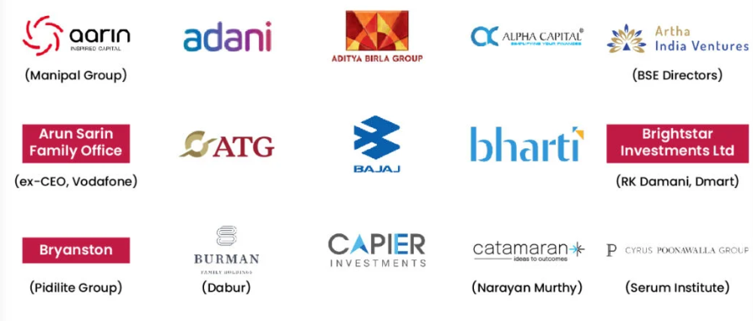
What is a Family Office?
A family office is a private company that manages a family's wealth and investments. They offer a variety of services, including financial planning, estate planning, and investment management

Slide 3
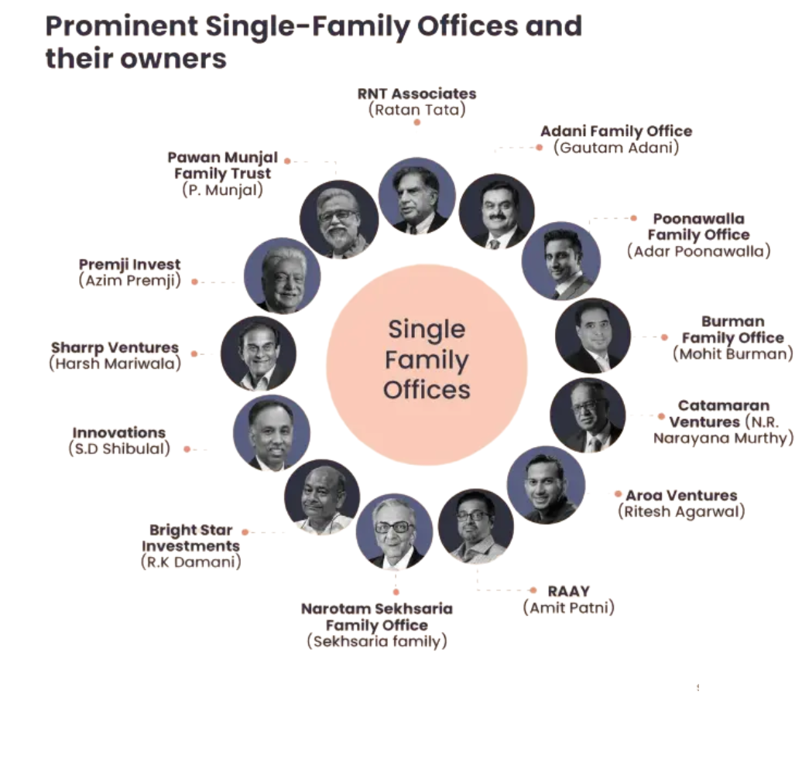

Slide 4
Purpose of a Family Office
Wealth Preservation & Growth
Direct Investments
Alternative Investments
Real Estate Investment
Fund Selection & Asset Allocation
Deal Sourcing & Strategic Partnerships
Liquidity & Risk Management
Generational Wealth Transfer & Succession Planning

Slide 5
Investment Avenues for Family
Offices
Family offices typically invest in a mix of traditional and alternative assets, including
Equities: Stocks, which are often the largest allocation in a family office's portfolio
Fixed income: Bonds, including high-yield bonds
Real estate: Commercial real estate
Private equity: Venture capital opportunities
Hedge funds: Align interests based on risk and return assessment goals
Cash: Savings accounts, money market funds, and Treasury bills
Art: Considered an excellent way to diversify portfolios
Cryptocurrencies: Digital assets that have regained interest from investors
Startups: Particularly in the fintech sector

Slide 6
Types of Family Offices
Feature | Single-Family Office (SFO) | Multi-Family Office (MFO)
Ownership | Fully owned and controlled by one family | Independently operated or jointly owned by multiple families
Customization | Highly customized to the specific needs of one family | Offers standardized solutions but can be tailored to individual families
Cost | High operating costs due to exclusive management | Cost-effective as expenses are shared among multiple families
Investment Strategy | Personalized investment strategy aligned with family goals | Broader investment strategies catering to multiple clients
Regulatory Compliance | Privately managed, requiring independent compliance setup | Often structured with established compliance and governance frameworks
Ideal For | Ultra-high-net-worth families willing to set up and manage their own office | High-net-worth families looking for professional management without the complexity of running an SFO

Slide 7
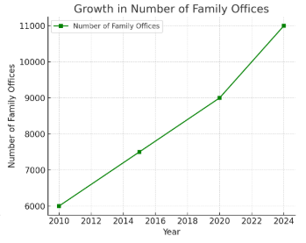
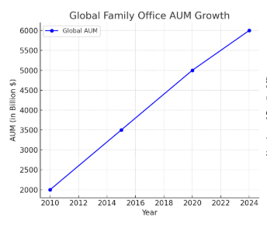
Growing Influence of Family Offices
A Global Landscape
As of 2024, the number of single-family offices worldwide has grown to approximately 8,030, marking a 31% increase from 6,130 in 2019
This growth trajectory is expected to continue, with projections estimating over 10,720 family offices by 2030, representing a 75% rise from 2019 levels
Collectively, family offices manage an impressive $5.9 trillion in assets, highlighting the substantial concentration of wealth within this sector

Slide 8
Growing Influence of Family Offices
Indian Landscape
India has witnessed a remarkable surge in family offices, growing from just 45 in 2010 to nearly 300 in 2024, a 567% increase over the past 14 years
The total Assets Under Management (AUM) of Indian family offices now stands at approximately $90 billion, reflecting the increasing sophistication of wealth management in the country
With India witnessing an unprecedented rise in ultra-high-net-worth individuals (UHNIs), the demand for structured family office solutions is expected to accelerate, driving further growth in this space

Slide 9
Why the Growing Popularity of
Family Offices?
Structured Wealth Management & Estate Planning
Surge in UHNW Families
Shift Toward Direct Investments
Regulatory Changes & Offshore Scrutiny
Diversification Across Asset Class

Slide 10
How to Set Up a Family Office in
India?
Step 1 Define objectives: Wealth preservation, investments, philanthropy, succession planning
Step 2 Legal structuring: Trusts, LLPs, Corporate Entities
Step 3 Regulatory compliance: SEBI, RBI, FEMA, Tax laws
Step 4 Team setup: Investment managers, legal & tax advisors, risk specialists

Slide 11
Tax Implications of Family Offices in
India
Capital Gains Tax
Listed Stocks & Mutual Funds: 10%-15% depending on holding period
Taxation Based on Structure
Trusts: Taxed at individual slab rates
Overseas Investments & FEMA Compliance
Subject to Liberalized Remittance Scheme (LRS) & DTAA benefits for foreign income
Dividend & Interest Taxation
Wealth Transfer & Estate Planning
Unlisted Shares & Private Equity: 20% with indexation for long-term gains
Dividends: Taxed at slab rates, TDS of 10% applies
Interest Income: Taxed as per slab rates
No inheritance tax, but gift tax applies in certain cases
Private trusts help with tax efficiency
LLPs/Companies: Corporate tax applies (22% under the new regime)

Slide 12
Common Challenges and Mistakes in
Setting Up a Family Office
Poor Communication & Transparency with Family Members
Casual Hiring Practices
Too Much, Too Fast
Hesitancy to leverage Advisor Relationships
Lack of Structural Flexibility
Not Treating the Family Office as a Business
Inadequate Focus on Data Security & Risk Management

Slide 13
Managing Own Wealth vs Outsourcing
to Fund Managers
Aspect | Managing Own Wealth | Outsourcing to Fund Managers
Control | Full control | Limited control
Expertise | Requires an in-house team | Access to professional fund managers
Cost | High fixed costs | Typically performance-based fees
Risk Management | Direct responsibility for risk assessment and mitigation | Managed risk through experienced professionals and diversified portfolios

Slide 14
Family Office vs AIF, PMS -Key Difference
Family Offices often consider other structured investment vehicles, such as Alternative Investment Funds (AIFs), Non-Banking Financial Companies (NBFCs), and Portfolio Management Services (PMS)
Feature | Family Office | AIF | PMS
Primary Purpose | Managing intergenerational wealth | Pooled investment in startups, PE, hedge funds | Managing high-net-worth portfolios
Control | Full control over investments | Limited—pooled fund structure | Customizable, but external management
Regulation | Flexible, customized for family needs | SEBI (Alternative Investment Fund Regulations) | SEBI (PMS Regulations)
Typical Investment | Direct investments in businesses, real estate, PE/VC | Startups, hedge funds, structured investments | Public equities, fixed income

Slide 15
Trends in Family Office Investments
(2025)
Emerging Sectors: AI, Fintech, Green Energy, Healthcare, SpaceTech
Geographic Focus: India, SE Asia, Middle East, Africa
Direct Investments: Preference for direct startup stakes over LP roles in funds
Sustainable Investing: ESG and impact-driven investment strategies gaining traction
Digital Assets: Select family offices exploring blockchain and tokenized assets
Co-Investments: Increased partnerships with PE firms, VCs, and other family offices

Slide 16
Family Offices: A Strategic
Investment Powerhouse
Long-Term Investment Approach
Family Offices focus on value creation over multiple generations, prioritizing sustainable and strategic investments rather than short-term gains.
Unlike Venture Capital firms, which operate on fixed fund cycles, Family Offices provide patient capital, allowing businesses the flexibility to scale at a natural pace.
This makes them ideal investors in capital-intensive and R&D-driven sectors such as DeepTech, CleanTech, and Semiconductors, where product development and commercialization take time.

Slide 17
Family Offices: A Strategic
Investment Powerhouse
Hands-On Deal Structuring & Exit Planning
Family Offices go beyond passive investing—they take an active role in structuring deals, ensuring optimized capital allocation, governance, and tax efficiency.
They carefully plan exit strategies, considering long-term value realization rather than short-term liquidity.
Strategic exits may include IPOs, secondary sales, or intergenerational transfers, ensuring wealth preservation.

Slide 18
Family Offices: A Strategic
Investment Powerhouse
Risk Mitigation Through Diversification & Global Exposure
To mitigate market volatility, Family Offices build highly diversified portfolios across:
Public & Private Markets – Equities, private equity, venture capital.
Alternative Assets – Hedge funds, commodities, structured credit.
Real Estate & Infrastructure – Revenue-generating assets with long-term appreciation.
Geographic Diversification – Investments across India, the US, Europe, and emerging markets.
This multi-asset, multi-geography approach protects against downturns and ensures steady wealth growth.

Slide 19
Family Offices: A Strategic
Investment Powerhouse
Beyond Capital: Strategic Market Insights & Value Addition
Family Offices offer more than just funding—they bring deep industry knowledge, strategic market insights, and a powerful network to their portfolio companies.
Their strong understanding of the Indian market, consumer behavior, and regulatory landscape helps startups navigate challenges and seize opportunities.
Key advantages:
Mentorship & Advisory – Helping founders refine business models and growth strategies.
Industry Connections – Access to supply chains, distributors, and government relations.
Operational Guidance – Best practices in governance, compliance, and financial structuring.

Slide 20
Types of Strategic Investments
Alternative Investments: Hedge Funds, Crypto, & Commodities
Strategic Mergers & Acquisitions (M&A)
ESG & Impact Investing
Direct Investments in Private Equity & Venture Capital
Supporting Innovation & Entrepreneurship
Real Estate & Infrastructure Investments

Slide 21
Types of Strategic Investments
Direct Investments in Private Equity & Venture Capital
Family Offices are increasingly bypassing traditional fund managers to directly invest in startups and private companies.
They act as angel investors or strategic partners, providing not just capital but also industry expertise and mentorship.
Examples:
Catamaran Ventures (Narayana Murthy, Infosys) – Strategic investments in technology and consumer businesses.
Premji Invest (Azim Premji, Wipro) – Investments in high-growth startups and mid-market companies.

Slide 22
Types of Strategic Investments
Strategic Mergers & Acquisitions (M&A)
Family Offices facilitate business expansion by acquiring strategic stakes in companies aligned with their portfolio.
They often act as long-term investors in succession planning for family-owned businesses
Example: Reliance Family Office acquiring startups and businesses in telecom, retail, and digital sectors to fuel Jio’s ecosystem.

Slide 23
Types of Strategic Investments
Real Estate & Infrastructure Investments
Real estate is a core asset class for Family Offices due to steady cash flows and long-term value appreciation.
Strategic investments include:
Commercial & residential properties for rental income and capital gains.
Logistics & warehousing to capitalize on e-commerce growth.
Renewable energy projects for ESG-focused investments.
Example: Tata Family Office’s focus on real estate & infrastructure development projects.

Slide 24
Types of Strategic Investments
ESG & Impact Investing
Many Family Offices align investments with their philanthropic and legacy goals, focusing on Environmental, Social, and Governance (ESG) principles.
Investments in clean energy, social impact funds, and sustainable businesses help them create long-term positive change.
Example: The Rockefeller Family Office pivoting towards sustainable investments and climate change initiatives.

Slide 25
Types of Strategic Investments
Alternative Investments: Hedge Funds, Crypto, & Commodities
To hedge risks and enhance returns, Family Offices invest in alternative assets such as:
Hedge funds for market-neutral strategies.
Cryptocurrencies and blockchain startups.
Commodities like gold, silver, and agricultural assets.
Example: The Ambani Family Office investing in blockchain and AI-driven startups.

Slide 26
Types of Strategic Investments
Supporting Innovation & Entrepreneurship
Family Offices back R&D, innovation hubs, and deep-tech startups, driving industrial and technological growth.
They often invest in family-run or closely aligned businesses that support their long-term wealth vision.
Example: The Walton Family Office (Walmart) investing in retail tech startups to enhance Walmart’s supply chain efficiency.

Slide 27
How Professional Wealth Structuring
Enhances Returns
Asset Allocation Across Private Equity, Real Estate, and Alternative Investments
Risk-Adjusted Investment Decisions for Optimal Wealth Growth
Access to Exclusive Global Investment Opportunities
Ultra-high-net-worth families benefit from private market access, which is not available to retail investors. These include: ✅ Pre-IPO and Anchor Investments – Investing in high-growth companies before they go public for exponential gains. ✅ Co-Investment Deals – Partnering with leading institutional investors and sovereign wealth funds in global projects. ✅ Direct Real Estate & Infrastructure Investments – Participating in exclusive real estate developments and private infrastructure projects worldwide.
Diversification is Key: A well-structured family office portfolio spreads investments across multiple asset classes to reduce overall risk. Instead of concentrating wealth in a single business or asset, families allocate funds into: ✅ Private Equity – Investing in startups, high-growth private companies, and venture capital for long-term wealth creation. ✅ Real Estate – Holding a mix of commercial, residential, and REITs (Real Estate Investment Trusts) for steady rental yields and capital appreciation. ✅ Alternative Investments – Hedge funds, commodities, art, collectibles, and even cryptocurrency for enhanced returns uncorrelated with traditional markets
Professional wealth managers use a data-driven approach to ensure every investment aligns with a family's risk appetite and return expectations.
Techniques Used: ✅ Modern Portfolio Theory (MPT) – Allocating assets in a way that maximizes returns for a given level of risk. ✅ Dynamic Risk Management – Hedging strategies, downside protection, and stress testing investment scenarios. ✅ Customized Liquidity Planning – Balancing long-term growth assets with liquid investments to maintain financial flexibility

Slide 28
What Makes Family Offices Different From Wealth Managers?

Slide 29
How Family Offices Support
Businesses Beyond Capital
Strategic Partnerships Connecting businesses with industry leaders & investors
Governance & Compliance
Improving risk management & regulatory structuring
Operational Expertise Supporting business expansion, restructuring, and tech adoption
Social Impact Support
Encouraging sustainable and responsible business practices
Mentorship & Advisory Guiding founders through funding, M&A, and IPOs

